Slide 1

TB BURDEN COUNTRY DATA ANALYSIS
Presented by Tanvi Takawale

Slide 2

INTRODUCTION
Tuberculosis (TB) remains a significant global health challenge, with millions of people affected each year. To better understand the burden of TB by country, we have undertaken a data analysis project using a comprehensive dataset. Our dataset includes key metrics such as estimated total population, prevalence of TB, mortality rates, and incidence rates, among others, for various countries and territories. By analyzing this data, we aim to identify trends, patterns, and disparities in TB burden across different regions and countries. This analysis will provide valuable insights for policymakers, researchers, and healthcare professionals working to combat TB on a global scale.

Slide 3

CONTENTS
Our dataset contains detailed information on the tuberculosis (TB) burden by country. It includes country names, ISO codes, regions, years, estimated population numbers, prevalence rates (with low and high bounds), mortality rates (excluding HIV and for HIV-positive cases), estimated number of deaths (with low and high bounds), methodological details, and estimated incidence rates.
This dataset enables a comprehensive analysis of TB burden, aiding in understanding trends, patterns, and disparities across different countries and regions.

Slide 4
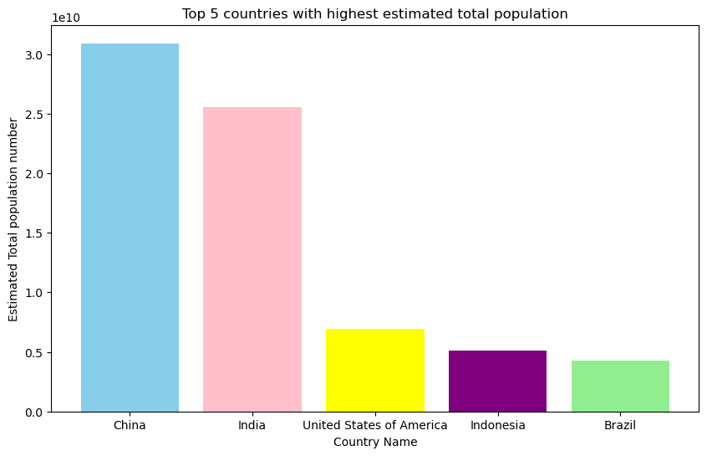
What are the top 5 countries with the highest estimated total population?
Highest estimated total population by Country or territory name
China : 30907331652
India : 25563539547
United States of America : 6906473630
Indonesia : 5136128634
Brazil : 4244854830

Slide 5
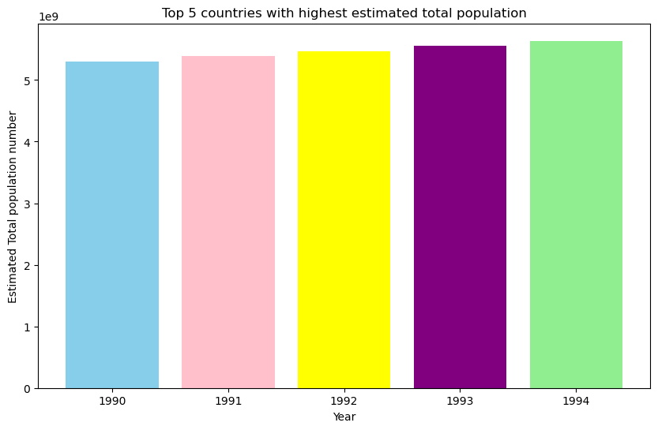
Calculate the highest estimated total population by year?
Highest estimated total population by Year
1990 : 5297723337
1991 : 5385563019
1992 : 5471299676
1993 : 5555014306
1994 : 5636995496

Slide 6
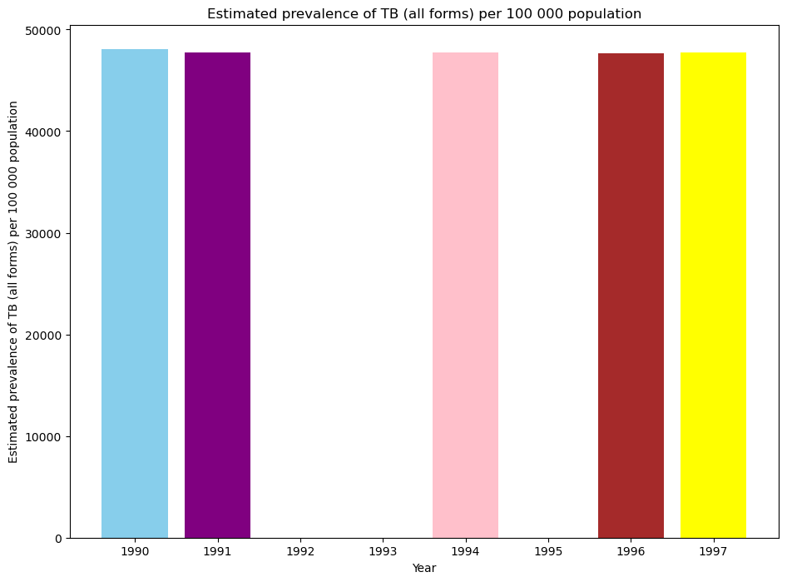
Calculated the average Estimated prevalence of TB (all forms) per 100 000 population by year?
Estimated prevalence of TB (all forms) per 100 000 population by Year
1990 : 48065.2
1994 : 47763.3
1997 : 47750.8
1991 : 47750.3
1996 : 47650.4

Slide 7
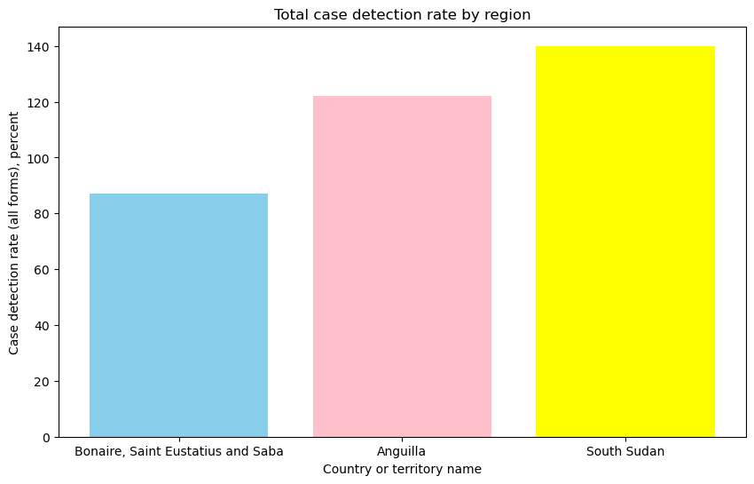
How does Case detection rate vary by year?
Total case detection rate by Country or territory name
Bonaire, Saint Eustatius and Saba 87.0
Anguilla 122.0
South Sudan 140.0

Slide 8
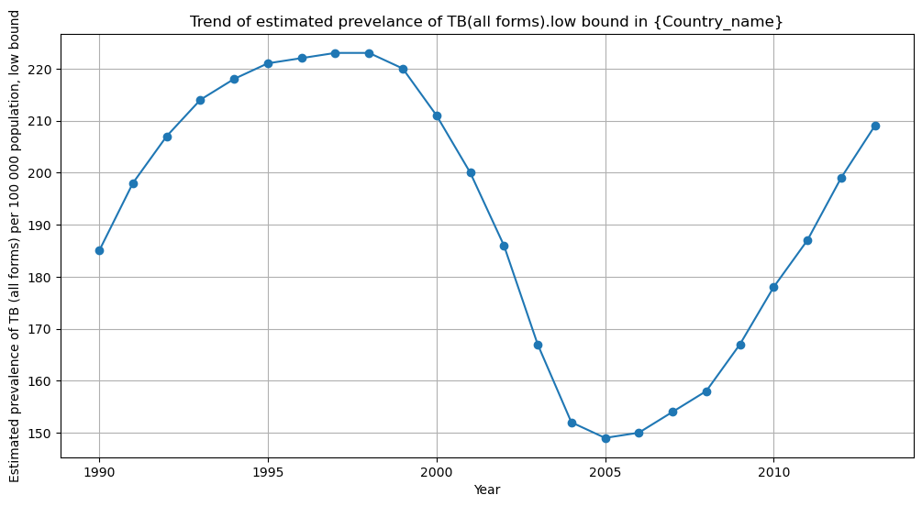
What is trend of the estimated prevalence of TB (all forms),low bound over the years for a specific country?

Slide 9
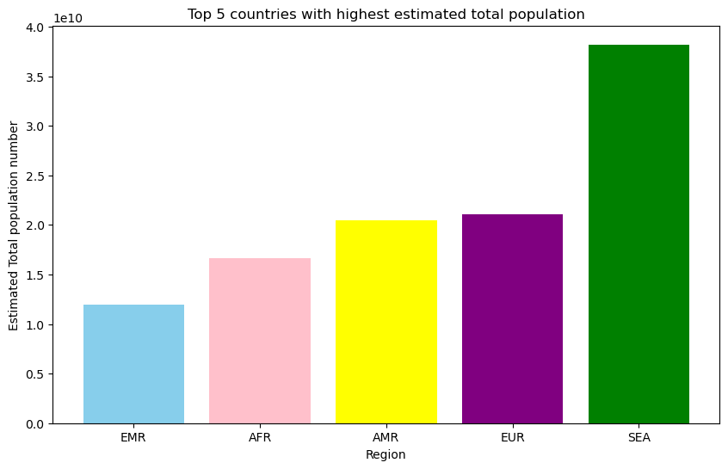
Calculate the highest estimated total population by Region?
Highest estimated total population by Region
EMR : 11936276692
AFR : 16622102766
AMR : 20467595830
EUR : 21032782394
SEA : 38194076821

Slide 10
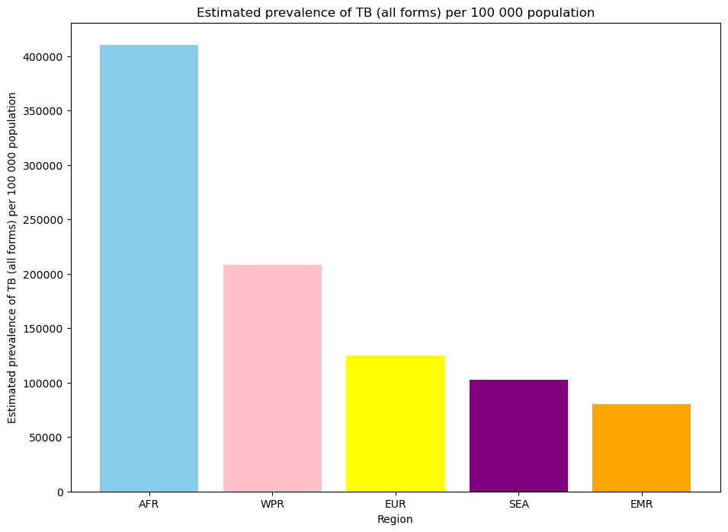
Calculated the average Estimated prevalence of TB (all forms) per 100 000 population by Region?
Estimated prevalence of TB (all forms) per 100 000 population by Region
AFR : 410334.00
WPR : 208538.10
EUR : 125238.65
SEA : 102723.00
EMR : 80586.90

Slide 11
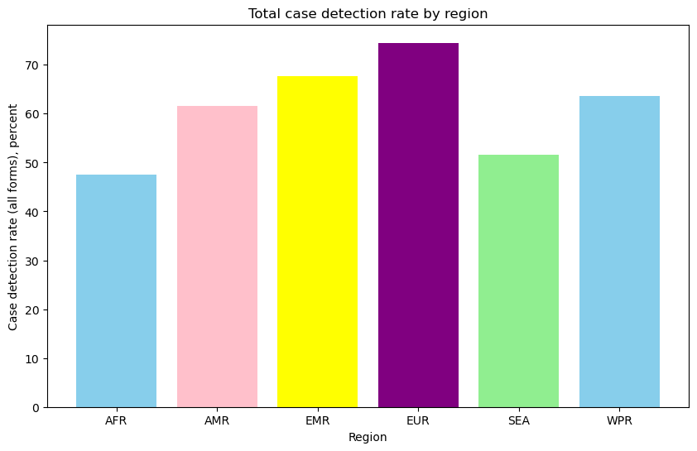
How does Case detection rate vary by region?
Total case detection rate by Region
AFR : 47.494128
AMR : 61.547059
EMR : 67.744470
EUR : 74.500312
SEA : 51.587302
WPR : 63.544444

Slide 12
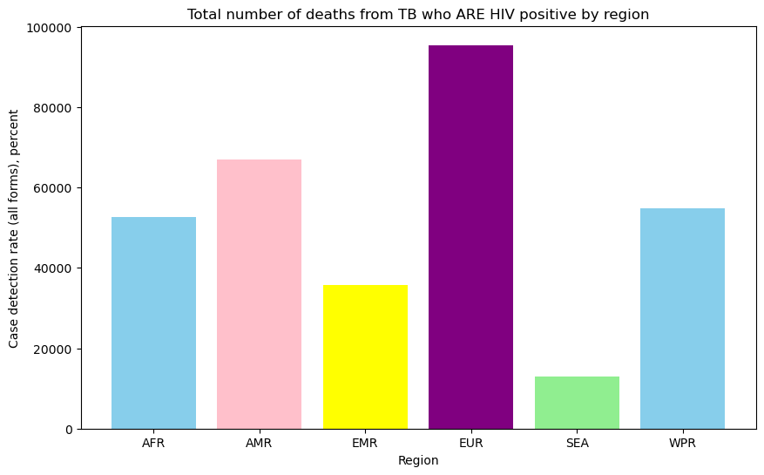
How does the estimated number of deaths from TB in people who are HIV-positive , High bound vary by region?
Total number of deaths from TB who ARE HIV positive by Region
AFR : 52576.00
AMR : 66963.20
EMR : 35769.08
EUR : 95434.90
SEA : 13000.00
WPR : 54902.40

Slide 13
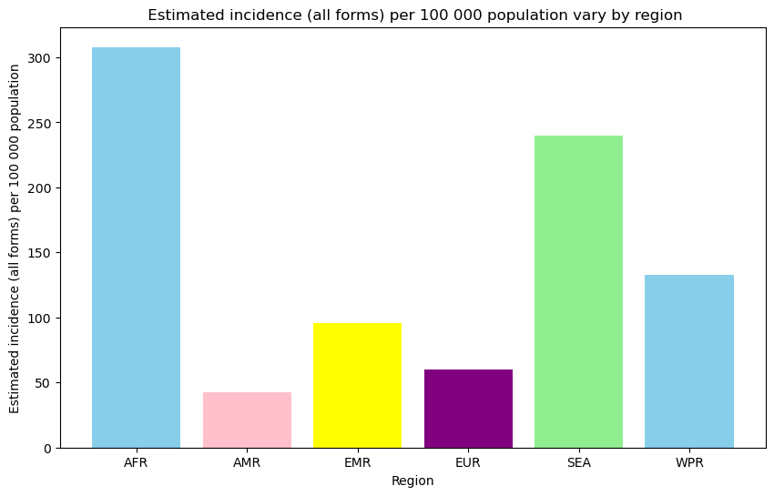
How does the estimated incidence (all forms) per 100,000 population vary by region?
Estimated incidence (all forms) per 100 000 population vary by Region
AFR 307.879313
AMR 42.472978
EMR 95.959280
EUR 59.872186
SEA 239.638889
WPR 132.926968

Slide 14
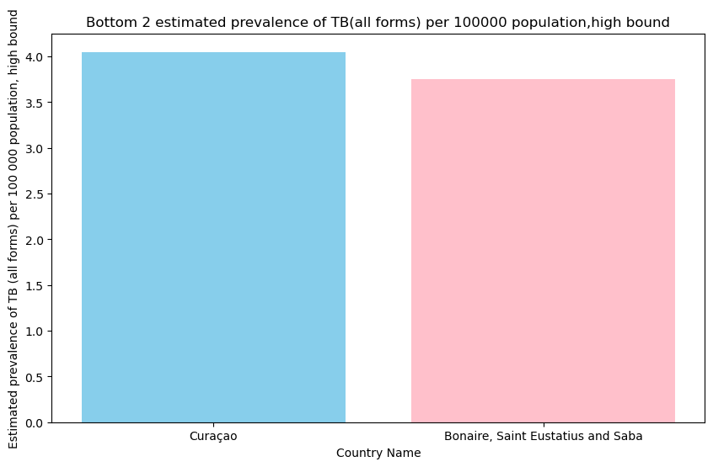
Calculate bottom 2 Estimated prevalence of TB (all forms) per 100 000 population, high bound by Country name?
Lowest Estimated prevalence of TB (all forms) per 100 000 population, high bound by Country or territory name
Curaçao : 4.05
Bonaire, Saint Eustatius and Saba : 3.75

Slide 15
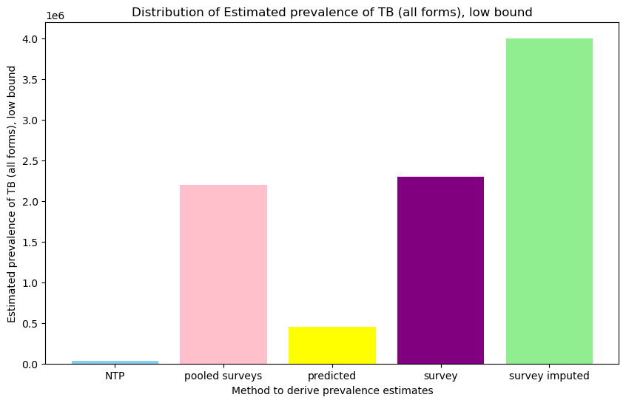
Calculate maximum Estimated prevalence of TB (all forms),low bound by Method to derive prevalence estimates?
Estimated prevalence of TB (all forms), low bound by Method to derive prevalence estimates
NTP 36000.0
pooled surveys 2200000.0
predicted 450000.0
survey 2300000.0
survey imputed 4000000.0

Slide 16
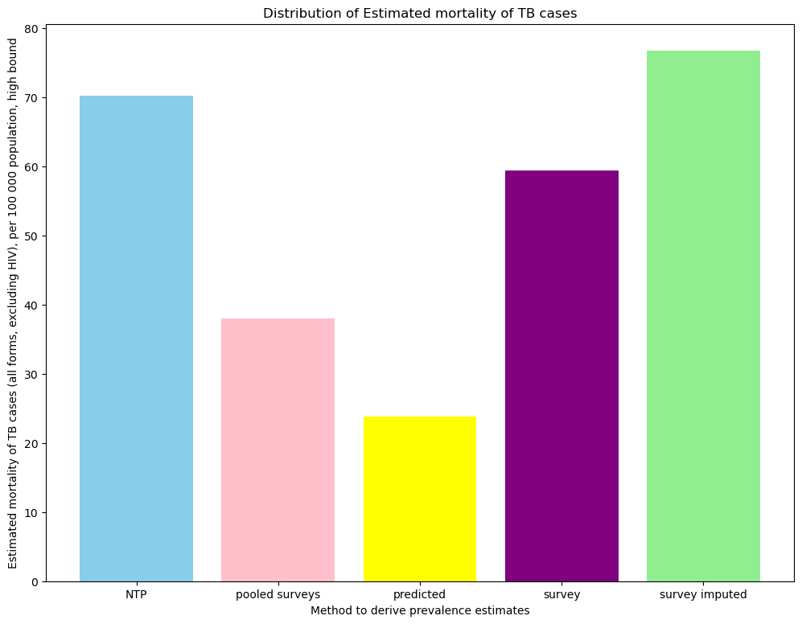
How does the method to derive prevalence estimates affect the estimated mortality of TB cases(all forms,excluding HIV) per 100,000 population,high bound?
Estimated mortality of TB cases (all forms, excluding HIV), per 100 000 population, high bound by Method to derive prevalence estimates
NTP 70.169167
pooled surveys 38.000000
predicted 23.789901
survey 59.393333
survey imputed 76.756419

Slide 17
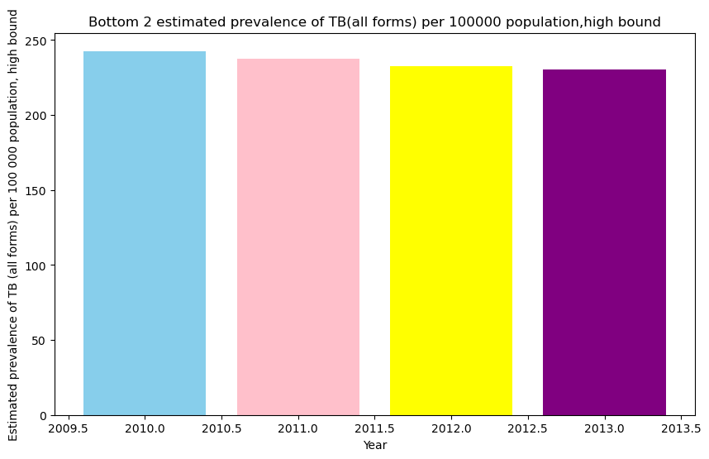
Calculate bottom 4 Estimated prevalence of TB (all forms) per 100 000 population, high bound by Year?
lowest Estimated prevalence of TB (all forms) per 100 000 population, high bound by Year
2010 242.632407
2011 237.386175
2012 232.528111
2013 230.406313

Slide 18
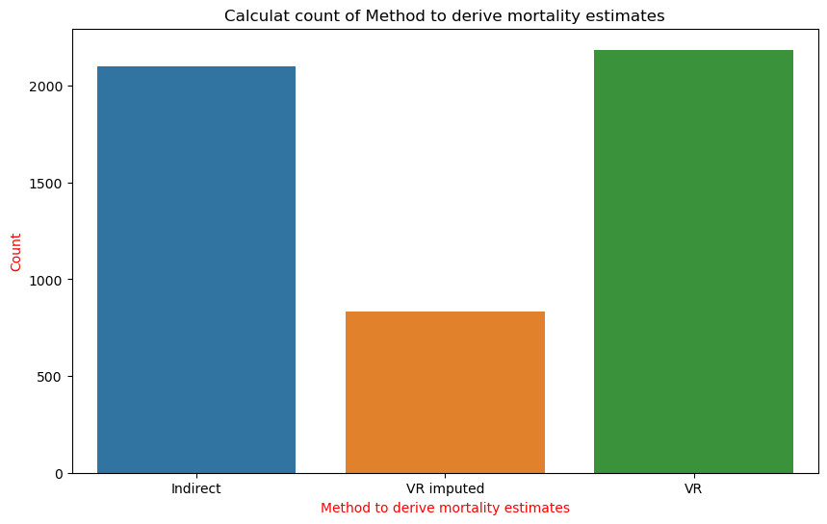
Calculate the count of Method to derive mortality estimates?
Calculate average Method to derive mortality estimates by
VR 2186
Indirect 2099
VR imputed 835

Slide 19


